Slide 1

Machine Learning and Data Mining
Lecture 2.1: Linear Regression

Slide 3

Why do we care about probability?
The world is a very uncertain place
30 years of Artificial Intelligence research danced around this fact
Then some AI researchers decided to use some ideas from the eighteenth century to model uncertainty…
For us: Really useful view of machine learning (both in practice for algorithm design and for deriving theoretic results about learning)
ML
Machine
Learning
Machine
Learning
Machine
Learning
Machine
Learning
Statistics
Slide adapted from Dhruv Batra. Comic a modification from 2016 webcomic Shen Comix.

Slide 4


Your First Probabilistic Learning Algorithm: MLE
After taking this course, you drop out of OSU and join an illegal betting company focused on underground mascot fights because you want to start making some real money with ML.
Your new boss asks you:
If Benny Beaver and the Oregon Duck face off, what is the probability Benny wins?
Knowing that data is everything, you ask:
What happened in the past? W, W, L, L, W
VS
You say P(Benny Wins) = ?
Why?
This slide in no way condones or encourages underground mascot fights or illegal gambling. Even if we would win.

Slide 5
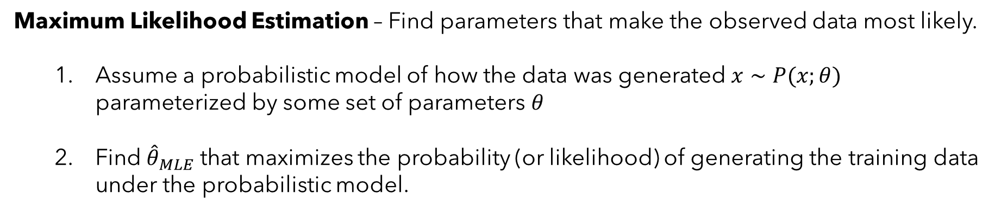
Your First Probabilistic Learning Algorithm: MLE
The intuitive answer is that 3/5 “fits the data” the best. We’ll formalize that notion this lecture.
Maximum Likelihood Estimation – Find parameters that make the observed data most likely.
Assume a probabilistic model of how the data was generated $x∼P(x;θ)$ parameterized by some set of parameters $θ$
Find ${\hat{θ}}_{MLE}$ that maximizes the probability (or likelihood) of generating the training data under the probabilistic model.
Why MLE?
Often leads to “natural” or intuitive parameter estimates
MLE is optimal if model class is correct (e.g. Normal model for normally distributed data)

Slide 6

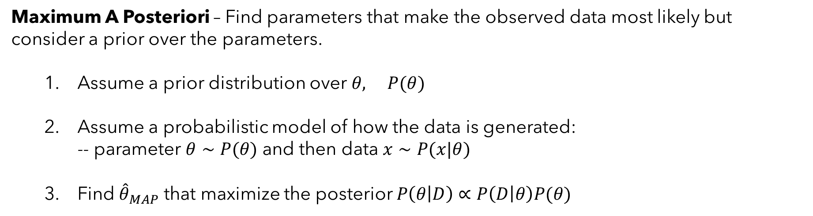
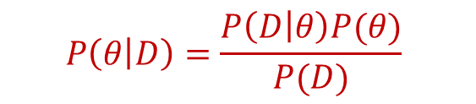
Your Second Statistical Learning Algorithm: MAP
Maximum A Posteriori – Find parameters that make the observed data most likely but consider a prior over the parameters.
Assume a prior distribution over $θ, P(θ)$
Assume a probabilistic model of how the data is generated: -- parameter $θ∼P(θ)$ and then data $x∼P(x|θ)$
Find ${\hat{θ}}_{MAP}$ that maximize the posterior $P\left(θ | D\right)∝P\left(D | θ\right)P(θ)$
$$P\left(θ | D\right)=\frac{P\left(D | θ\right)P(θ)}{P(D)}$$
Why MAP?
Rigorous framework to combine observations (likelihood) with beliefs (prior)

Slide 7
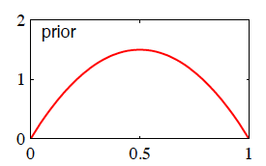
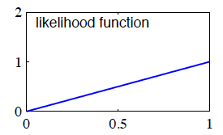
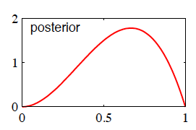
Effect of Prior on Coin Flip
Prior = Beta(2,2)
θ_{prior} = 0.5
Dataset = {H}
L(θ) = θ
θ_{MLE} = 1
Posterior = Beta(3,2)
θ_{MAP} = (3-1)/(3+2-2) = 2/3

Slide 8
Be able to answer:
What is linear regression?
How do we find a solution for it?
With one dimensional input?
With multidimensional input?
We’ll need to review some linear algebra
How does this relate to MLE? Hint: Gaussians!
What is regularization and how do they relate to priors from Bayesian statistics?

Slide 9
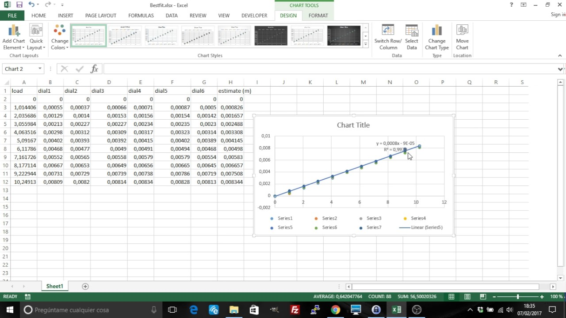
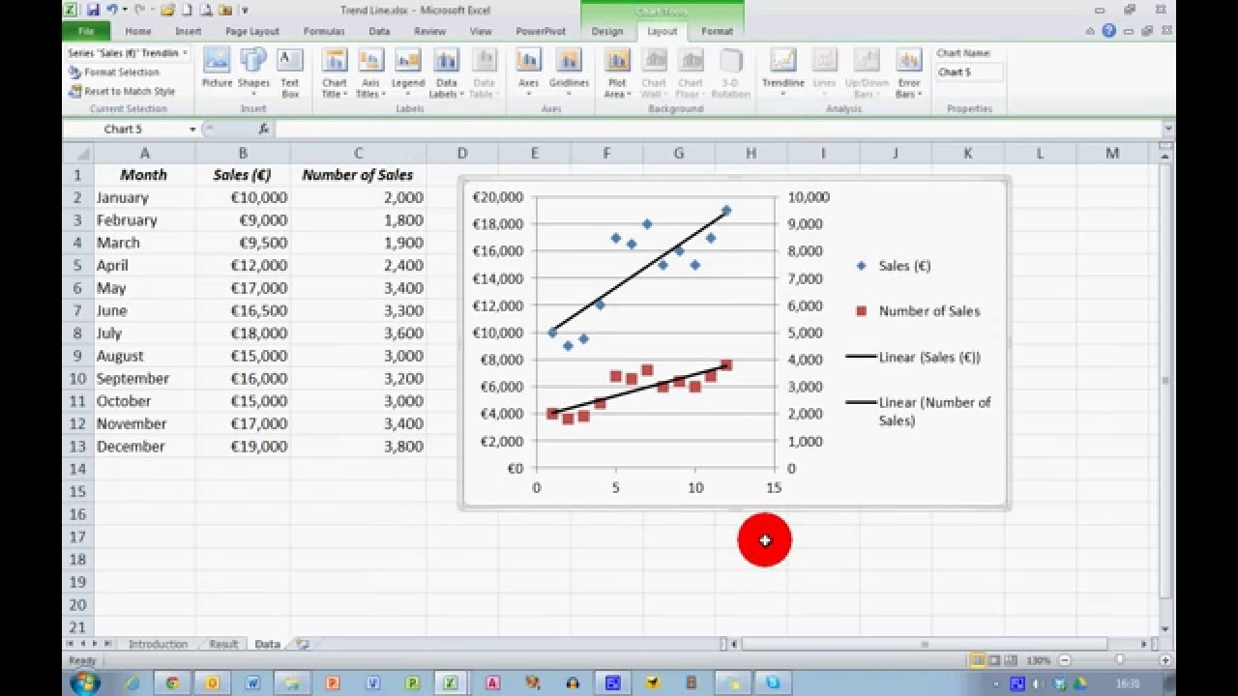
Linear Regression
Regression → We are predicting some continuous output y
Linear → We assume there is a linear relationship between input x and output y

Slide 10


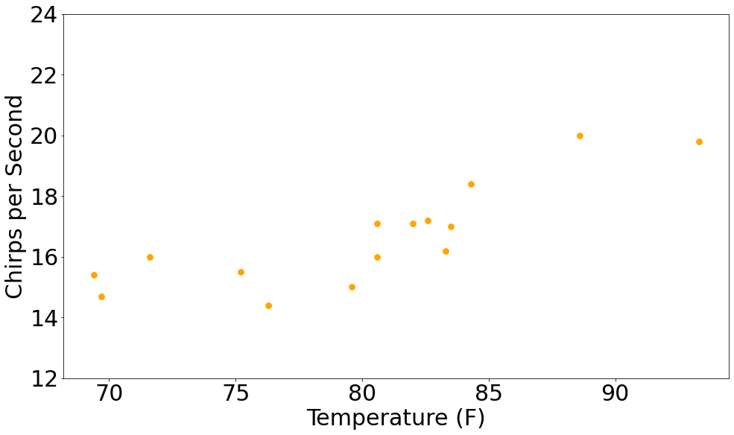
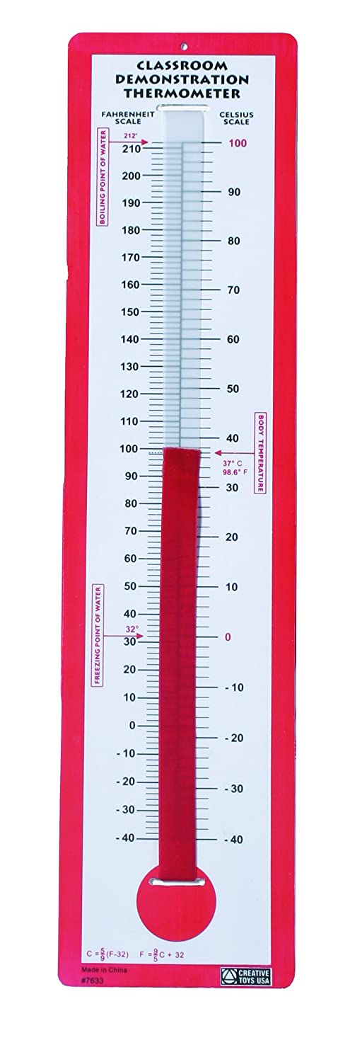
An Example Linear Regression Problem
Can we predict how annoying crickets will be based on the temperature?
X | Y
F | CPS
88.6 | 20
71.6 | 16
93.3 | 19.8
84.3 | 18.4
80.6 | 17.1
75.2 | 15.5
69.7 | 14.7
82 | 17.1
69.4 | 15.4
83.3 | 16.2
79.6 | 15
82.6 | 17.2
80.6 | 16.
83.5 | 17
76.3 | 14.4
Data from: The Song of Insects by Dr.G.W. Pierce, Harvard College Press

Slide 11
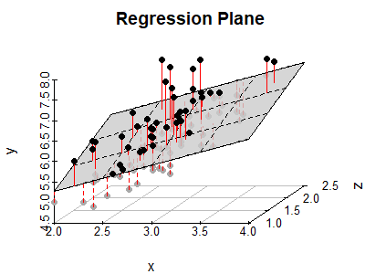

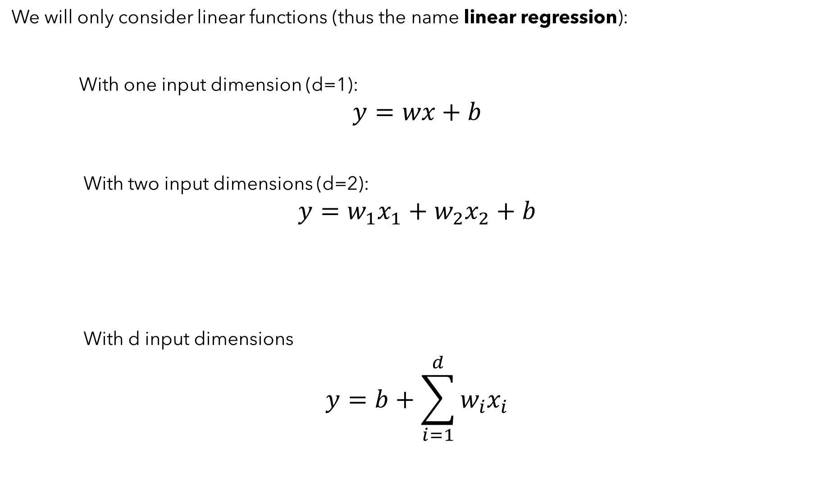
Formalizing Linear Regression A Bit
We will only consider linear functions (thus the name linear regression):
With one input dimension (d=1):
$$y=wx+b$$
With two input dimensions (d=2):
$$y=w_{1}x_{1}+w_{2}x_{2}+b$$
With d input dimensions
$$y=b+\sum_{i=1}^{d}{w_{i}x_{i}}$$
Line
Plane
Hyperplane

Slide 12
Formalizing Linear Regression A Bit
Goal: fit a line through the points
Problem: the data isn’t perfectly a line… how to measure “goodness” of a line?
Data from: The Song of Insects by Dr.G.W. Pierce, Harvard College Press

Slide 13
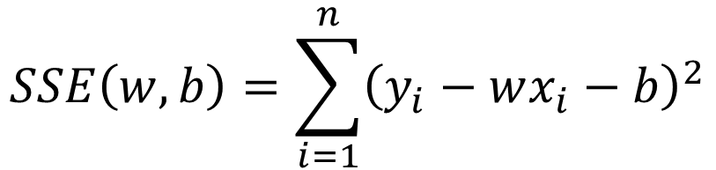
Formalizing Linear Regression A Bit
Dataset: Given a set of training examples $D={\left\{(x_{i}, y_{i}\right\}}_{i=1}^{n}$
X | Y
F | CPS
88.6 | 20
71.6 | 16
93.3 | 19.8
84.3 | 18.4
80.6 | 17.1
75.2 | 15.5
69.7 | 14.7
82 | 17.1
69.4 | 15.4
83.3 | 16.2
79.6 | 15
82.6 | 17.2
80.6 | 16.
83.5 | 17
76.3 | 14.4
Goal: Learn $w$ and $b$ such that $wx_{i}+b$ predict $y_{i}$ as closely as possible
In mathematical terms, we want to find $w$ and $b$ that minimize the error between $wx_{i}+b$ and $y_{i}$. How should we measure this error?
Let me suggest squared error (or L2) error -- ${\left(y_{i} −\left(wx_{i}+b\right)\right)}^{2}$
Why? Gaussians my dear Watson. Gaussians. Also is a convex function which will make solving it easier.
Objective: Find parameters that minimize the sum of squared error (SSE)
$$SSE\left(w,b\right)=\sum_{i=1}^{n}{{\left(y_{i}−wx_{i}−b\right)}^{2}}$$

Slide 14
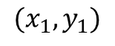
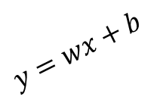
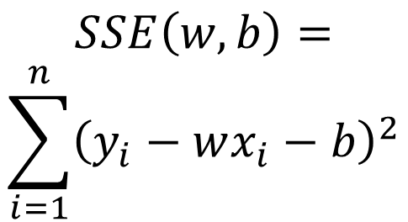
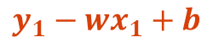
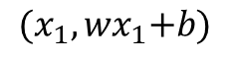
Visualizing Sum of Squared Error
$${(x_{1}, wx}_{1}+b)$$
$$SSE\left(w,b\right)= \\ \sum_{i=1}^{n}{{\left(y_{i}−wx_{i}−b\right)}^{2}}$$
$$y=wx+b$$
$$y_{1}−{wx}_{1}+b$$
$$(x_{1},y_{1})$$
Data from: The Song of Insects by Dr.G.W. Pierce, Harvard College Press

Slide 15
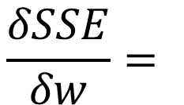
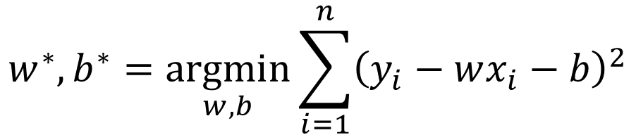
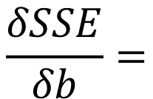
Minimizing Sum of Squared Error
Objective: Find parameters that minimize the sum of squared error (SSE)
$$w^{∗}, b^{∗}=\underset{w,b}{argmin}{\sum_{i=1}^{n}{{\left(y_{i}−wx_{i}−b\right)}^{2}}}$$
1) Take partial derivative w.r.t $w$ and $b$ respectively:
$$\frac{δSSE}{δw}=$$
$$\frac{δSSE}{δb}=$$

Slide 16
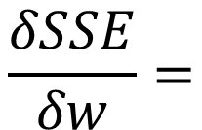
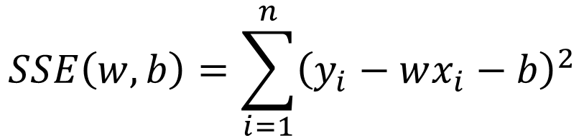
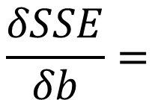
Find the partial derivative of the SSE objective w.r.t. w and b:
$$SSE\left(w,b\right)=\sum_{i=1}^{n}{{\left(y_{i}−wx_{i}−b\right)}^{2}}$$
$$\frac{δSSE}{δw}=$$
$$\frac{δSSE}{δb}=$$

Slide 17
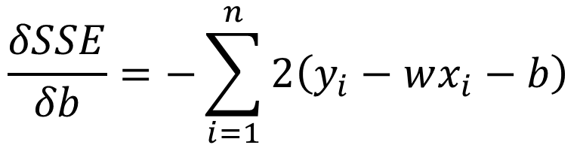
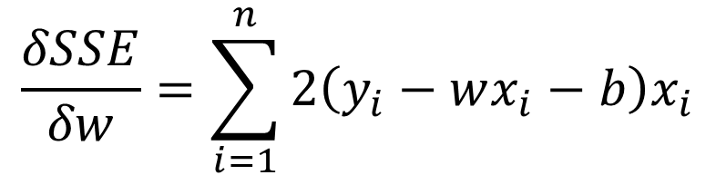
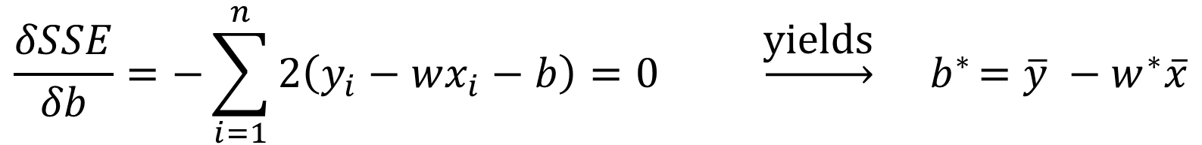
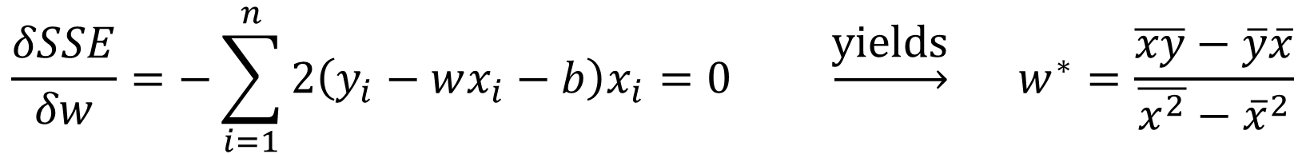
Minimizing Sum of Squared Error
1) Take partial derivative w.r.t $w$ and $b$ respectively:
$$\frac{δSSE}{δw}=\sum_{i=1}^{n}{2\left(y_{i}−wx_{i}−b\right)x_{i}}$$
$$\frac{δSSE}{δb}=−\sum_{i=1}^{n}{2\left(y_{i}−wx_{i}−b\right)}$$
2) Set equal to zero and solve:
$$\frac{δSSE}{δw}=−\sum_{i=1}^{n}{2\left(y_{i}−wx_{i}−b\right)x_{i}}=0 \underset{→}{\text{yields}} w^{∗}=\frac{\overline{xy}−\overline{y}\overline{x}}{\overline{x^{2}}−{\overline{x}}^{2}}$$
$$\frac{δSSE}{δb}=−\sum_{i=1}^{n}{2\left(y_{i}−wx_{i}−b\right)=0 }\underset{→}{\text{yields}}{ b}^{∗}=\overline{y} −w^{∗}\overline{x}$$

Slide 18


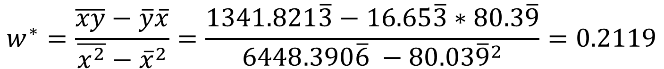


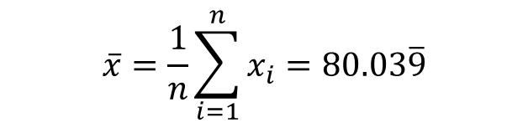
Checking Our Solution
Let’s see if this works:
X | Y
F | CPS
88.6 | 20
71.6 | 16
93.3 | 19.8
84.3 | 18.4
80.6 | 17.1
75.2 | 15.5
69.7 | 14.7
82 | 17.1
69.4 | 15.4
83.3 | 16.2
79.6 | 15
82.6 | 17.2
80.6 | 16.
83.5 | 17
76.3 | 14.4
$$\overline{x}=\frac{1}{n}\sum_{i=1}^{n}{x_{i}}=80.03\overline{9}$$
$$\overline{xy}=\frac{1}{n}\sum_{i=1}^{n}{x_{i}y_{i}}=1341.821\overline{3}$$
$$\overline{y}=\frac{1}{n}\sum_{i=1}^{n}{y_{i}}=16.65\overline{3}$$
$$\overline{x^{2}}=\frac{1}{n}\sum_{i=1}^{n}{x_{i}^{2}}=6448.390\overline{6}$$
$${\overline{x}}^{2}=6406.4015\overline{9}$$
$$w^{∗}=\frac{\overline{xy}−\overline{y}\overline{x}}{\overline{x^{2}}−{\overline{x}}^{2}}=\frac{1341.821\overline{3}−16.65\overline{3}∗80.3\overline{9}}{6448.390\overline{6} −80.03{\overline{9}}^{2}}=0.2119$$
${ b}^{∗}=\overline{y} −w^{∗}\overline{x}=16.65\overline{3}−0.2119∗80.03\overline{9}=−3.0914$

Slide 19
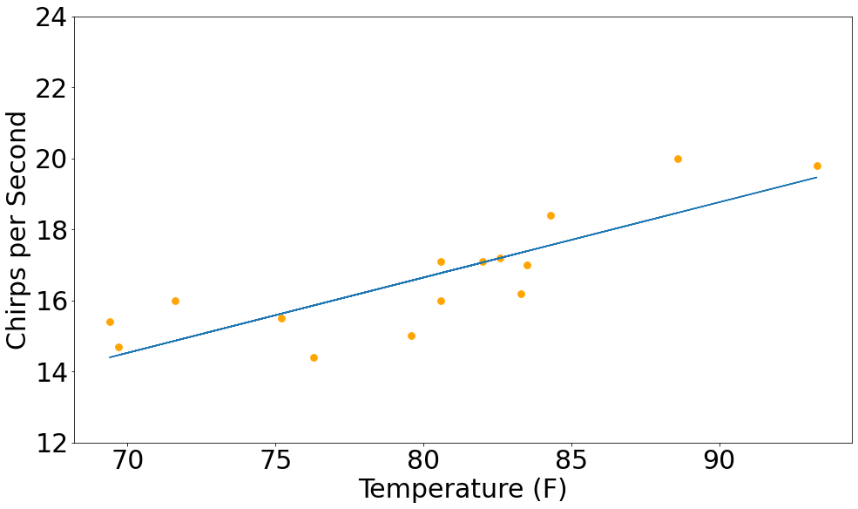
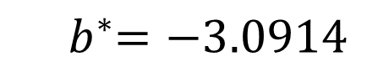
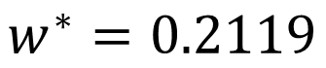
Formalizing Linear Regression A Bit
Let’s see if this works:
X | Y
F | CPS
88.6 | 20
71.6 | 16
93.3 | 19.8
84.3 | 18.4
80.6 | 17.1
75.2 | 15.5
69.7 | 14.7
82 | 17.1
69.4 | 15.4
83.3 | 16.2
79.6 | 15
82.6 | 17.2
80.6 | 16.
83.5 | 17
76.3 | 14.4
$$w^{∗}=0.2119$$
${ b}^{∗}=−3.0914$

Slide 20
Formalizing Linear Regression A Bit
We will only consider linear functions (thus the name linear regression):
With one input dimension (d=1):
$$y=wx+b$$
With two input dimensions (d=2):
$$y=w_{1}x_{1}+w_{2}x_{2}+b$$
With d input dimensions
$$y=b+\sum_{i=1}^{d}{w_{i}x_{i}}$$
Line
Nailed it
Plane
Hyperplane

Slide 21
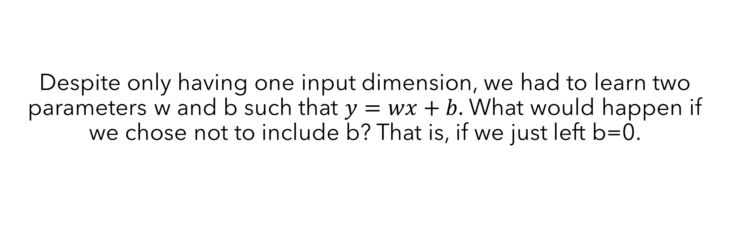
Despite only having one input dimension, we had to learn two parameters w and b such that $y=wx+b.$ What would happen if we chose not to include b? That is, if we just left b=0.
The line would have to be horizontal
Nothing. w would adjust to recover the same solution as if b was there.
The line would have to go through the origin
The line would not be defined

Slide 22
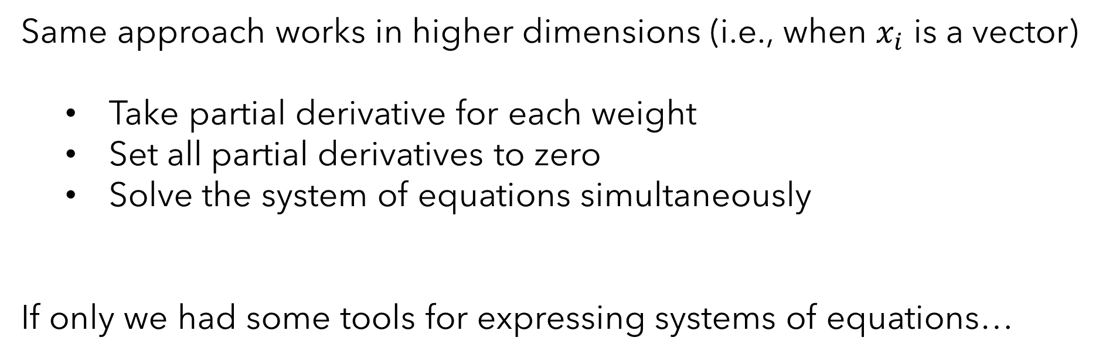
Extending to Higher Dimensions
Same approach works in higher dimensions (i.e., when $x_{i}$ is a vector)
Take partial derivative for each weight
Set all partial derivatives to zero
Solve the system of equations simultaneously
If only we had some tools for expressing systems of equations…
Time for a brief linear algebra and vector calculus “review”!

Slide 23
Linear Algebra Review

Slide 24
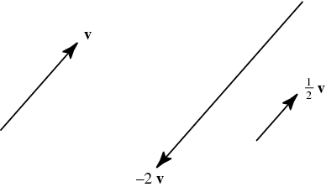
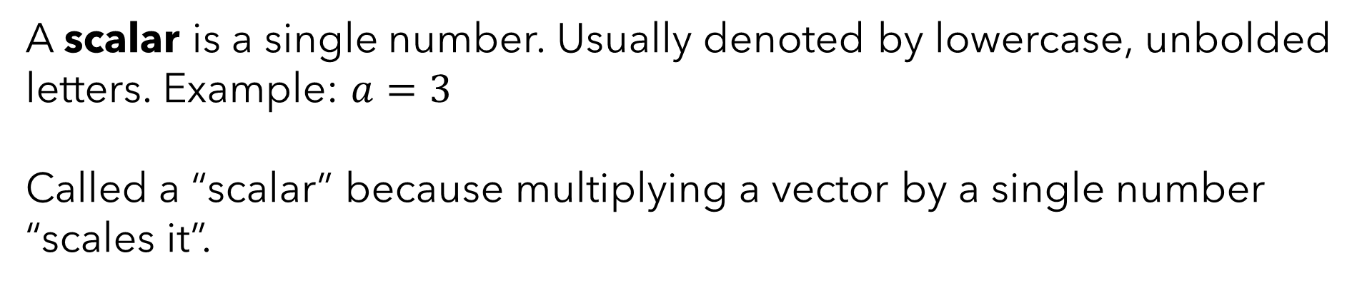
Linear Algebra Review
A scalar is a single number. Usually denoted by lowercase, unbolded letters. Example: $a=3$
Called a “scalar” because multiplying a vector by a single number “scales it”.

Slide 25
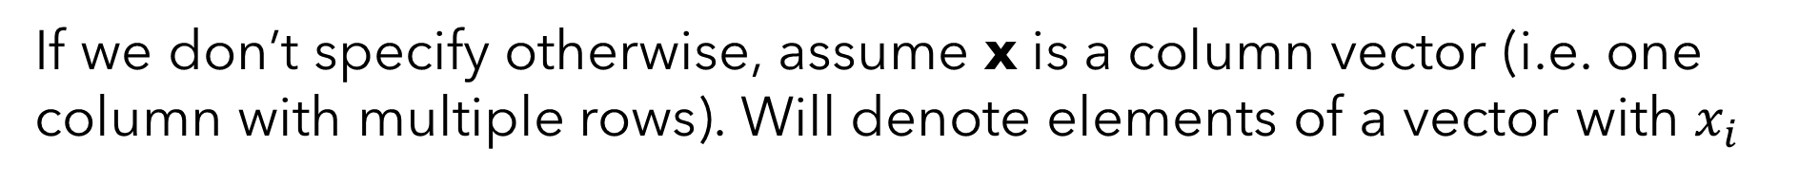

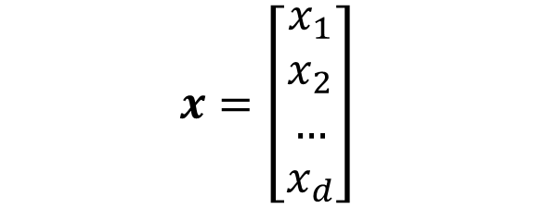
Linear Algebra Review
A vector is a one-dimensional array. Typically denote vectors as boldface lower case letters. Example:
$$x=\left[\begin{matrix}2 \\ 3 \\ −2\end{matrix}\right]$$
If we don’t specify otherwise, assume x is a column vector (i.e. one column with multiple rows). Will denote elements of a vector with $x_{i}$
$$x=\left[\begin{matrix}x_{1} \\ x_{2} \\ … \\ x_{d}\end{matrix}\right]$$

Slide 26

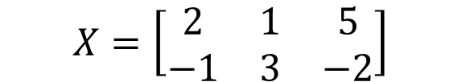

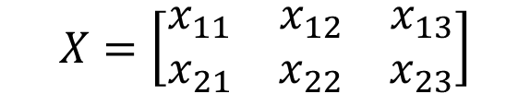
Linear Algebra Review
A matrix is a two-dimensional array. Typically denote matrices as unbolded upper case letters. Example:
$$X=\left[\begin{matrix}2 & 1 & 5 \\ −1 & 3 & −2\end{matrix}\right]$$
Will denote elements of a row with $x_{ij}$ where i is the row and j is the column:
$$X=\left[\begin{matrix}x_{11} & x_{12} & x_{13} \\ x_{21} & x_{22} & x_{23}\end{matrix}\right]$$
Will talk about the shape/size/dimensionality of a matrix as number of rows x number of columns. Example: $X$ has shape $2×3$

Slide 27
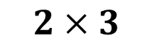
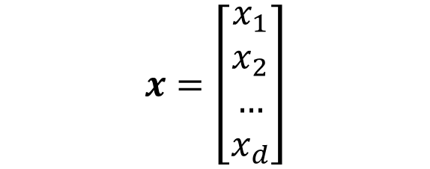
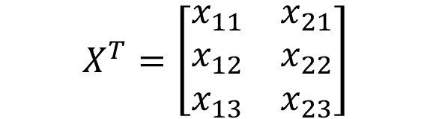
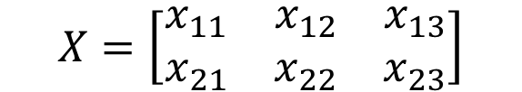
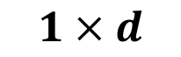
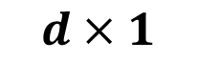
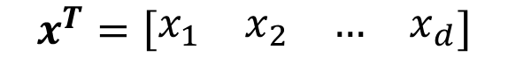
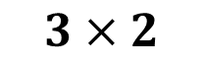
Linear Algebra Review
Transposition (or the transpose operator) swaps rows and columns:
$$x=\left[\begin{matrix}x_{1} \\ x_{2} \\ … \\ x_{d}\end{matrix}\right]$$
$$x^{T}=\left[\begin{matrix}\begin{matrix}x_{1} & x_{2}\end{matrix} & \begin{matrix}… & x_{d}\end{matrix}\end{matrix}\right]$$
$$1×d$$
$$d×1$$
$$X^{T}=\left[\begin{matrix}x_{11} & x_{21} \\ x_{12} & x_{22} \\ x_{13} & x_{23}\end{matrix}\right]$$
$$X=\left[\begin{matrix}x_{11} & x_{12} & x_{13} \\ x_{21} & x_{22} & x_{23}\end{matrix}\right]$$
$$2×3$$
$$3×2$$
As a result, shape of the matrix swaps to. If X is n-by-m, then $X^{T}$ is m-by-n

Slide 28
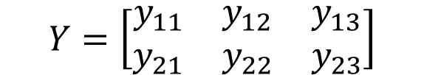


Linear Algebra Review
Matrix addition only defined for matrices of identical shape. Then is just performed element-wise:
$$X=\left[\begin{matrix}x_{11} & x_{12} & x_{13} \\ x_{21} & x_{22} & x_{23}\end{matrix}\right]$$
$$Y=\left[\begin{matrix}y_{11} & y_{12} & y_{13} \\ y_{21} & y_{22} & y_{23}\end{matrix}\right]$$
$$X+Y=\left[\begin{matrix}x_{11}+y_{11} & x_{12}+y_{12} & x_{13}+y_{13} \\ x_{21}+y_{21} & x_{22}+y_{22} & x_{23}+y_{23}\end{matrix}\right]$$
Output shape is the same as the input shapes.

Slide 29


Linear Algebra Review
Matrix multiplication only defined for matrices with identical inner dimensions. An m-by-n matrix can be multiplied by an r-by-c matrix if and only if n=r:
$$C=AB$$
$$c_{ij}=\sum_{k}^{n}{a_{ik}∗b_{kj}}$$
Output shape is the outer dimensions of the matrices – m-by-c in this case.

Slide 30

Linear Algebra Review
Matrix multiplication only defined for matrices with identical inner dimensions. An m-by-n matrix can be multiplied by an r-by-c matrix if and only if n=r:
Output shape is the outer dimensions of the matrices – m-by-c in this case.

Slide 31

Linear Algebra Review
Matrix multiplication only defined for matrices with identical inner dimensions. Unlike scalar multiplications, not commutative.

Slide 32




Linear Algebra Review
Vector multiplication defined the same as matrix multiplication. Because vectors are just matrices with one dimension being 1.
$$\left[\begin{matrix}\begin{matrix}y_{1} & y_{2}\end{matrix} & \begin{matrix}… & y_{d}\end{matrix}\end{matrix}\right]\left[\begin{matrix}x_{1} \\ x_{2} \\ … \\ x_{d}\end{matrix}\right]=y_{1}x_{1}+y_{2}x_{2}+…+y_{d}x_{d}$$
This is often called the inner (or dot) product of two vectors. $\left\langle x,y\right\rangle =\left(x⋅y\right)$ or $x^{T}y$ if x and y are both column vectors.
This is often called the outer product of two vectors. $x⨂y$ or $xy^{T}$ if x and y are both column vectors.
$$\left[\begin{matrix}x_{1} \\ x_{2} \\ … \\ x_{d}\end{matrix}\right]\left[\begin{matrix}\begin{matrix}y_{1} & y_{2}\end{matrix} & \begin{matrix}… & y_{d}\end{matrix}\end{matrix}\right]=\left[\begin{matrix}x_{1}y_{1} & x_{1}y_{2} & x_{1}y_{3} \\ x_{2}y_{1} & x_{2}y_{2} & x_{2}y_{3} \\ x_{3}y_{1} & x_{3}y_{2} & x_{3}y_{3}\end{matrix}\right]$$

Slide 33



Let $A∈ℝ^{m×n},B∈ℝ^{m×n}, v∈ℝ^{mx1}$, what is wrong with the following expression:
$${\left(A^{T}v\right)}^{T}B^{T}+B^{T}\left(v⨂v\right)v$$
${\left(A^{T}v\right)}^{T}B^{T}$ violates the rules of matrix multiplication
Nothing is wrong with it
It violates the rules of matrix addition
$B^{T}\left(v⨂v\right)v$ violates the rules of matrix multiplication

Slide 34


Linear Algebra Review
Vector norms define the “length” of a vector (or its distance from the zero vector). L2 should look familiar:
$${\left|\left|x\right|\right|}_{2}=\sqrt{x_{1}^{2}+x_{2}^{2}+…+x_{d}^{2}}=\sqrt{x⋅x}$$
Our friend the Minkowski distance still hanging around as the Lp norm:
$${\left|\left|x\right|\right|}_{p}={\left(\sum_{i=1}^{d}{{\left|x_{i}\right|}^{p}}\right)}^{\frac{1}{p}}$$

Slide 35


Let $v={\left[7, 6\right]}^{T} and w={\left[3, 3\right]}^{T}$, what is ${\left|\left|v−w\right|\right|}_{2}$?
$$7$$
[4,3]
5
104

Slide 36






Linear Algebra Review
Matrix inverse of a square matrix $A$ is a matrix $A^{−1}$such that $AA^{−1}=A^{−1}A=I$, where $I$ is called an identity matrix.
$$A=\left[\begin{matrix}1 & 0 \\ 1 & \frac{1}{2}\end{matrix}\right]$$
$$A^{−1}=\left[\begin{matrix}1 & 0 \\ −2 & 2\end{matrix}\right]$$
$\left[\begin{matrix}1 & 0 \\ 1 & \frac{1}{2}\end{matrix}\right]$ $\left[\begin{matrix}1 & 0 \\ −2 & 2\end{matrix}\right]=\left[\begin{matrix}1 & 0 \\ 0 & 1\end{matrix}\right]$
A square matrix A is invertible iff its determinant is nonzero.
We won’t play much with non-invertible matrices.
Some properties:

Slide 37

If $x∈ℝ^{d×1}$ (x is a d-dimensional column vector), what would I call the operation $xx^{T}$ and what shape would the result have?
Dot product, 1x1
Inner product, 1x1
Outer product, dxd
Cartesian product, dx1

Slide 38
Linear Algebra Review

Slide 39

Extending to Higher Dimensions
Same approach works in higher dimensions (i.e., when $x_{i}$ is a vector)
Take partial derivative for each weight
Set all partial derivatives to zero
Solve the system of equations simultaneously

Slide 40



Multidimensional Linear Regression
Now we consider the more general case that considers multiple input features.
In this example, each datapoint now has a 2-dimensional input $x={\left[x_{1}, x_{2}\right]}^{T}$ where $x_{1}$is temperature and $x_{2}$is humidity.
X |  | Y
F | H | CPS
88.6 | 30 | 20
71.6 | 28 | 16
93.3 | 32 | 19.8
84.3 | 30 | 18.4
80.6 | 29 | 17.1
75.2 | 24 | 15.5
69.7 | 20 | 14.7
82 | 30 | 17.1
69.4 | 19 | 15.4
83.3 | 30 | 16.2
79.6 | 28 | 15
82.6 | 32 | 17.2
80.6 | 30 | 16.
83.5 | 30 | 17
76.3 | 24 | 14.4
Want to learn: $y=w_{1}x_{1}+w_{2}x_{2}+b$
It is inconvenient to have to represent b separately, so we use a small trick to fold it in to w.
Add a feature to each x that is a constant 1 -- $x={\left[1, x_{1}, x_{2}\right]}^{T}$ and let $w={\left[b, w_{1}, w_{2}\right]}^{T}$
Now $y=w^{T}x=1b+x_{1}w_{1}+x_{2}w_{2}$

Slide 41


Multidimensional Linear Regression
How can we express the Sum of Squared Error objective?
$$SSE\left(w,b\right)=\sum_{i=1}^{n}{{\left(y_{i}−wx_{i}−b\right)}^{2}}$$
One-dimensional Version:
$$SSE\left(w\right)=\sum_{i=1}^{n}{{\left(y_{i}−w^{T}x_{i}\right)}^{2}}$$
Vectorized Multi-dimensional Version:

Slide 42






Multidimensional Linear Regression
Can we express it entirely as matrix operations?!
X |  | Y
F | H | CPS
88.6 | 30 | 20
71.6 | 28 | 16
93.3 | 32 | 19.8
84.3 | 30 | 18.4
80.6 | 29 | 17.1
75.2 | 24 | 15.5
69.7 | 20 | 14.7
82 | 30 | 17.1
69.4 | 19 | 15.4
83.3 | 30 | 16.2
79.6 | 28 | 15
82.6 | 32 | 17.2
80.6 | 30 | 16.
83.5 | 30 | 17
76.3 | 24 | 14.4
$$X=\left[\begin{matrix}{ x}_{1}^{T} \\ x_{2}^{T} \\ ⋮ \\ x_{n}^{T}\end{matrix}\right]$$
$$y=\left[\begin{matrix}y_{1} \\ y_{2} \\ ⋮ \\ y_{n}\end{matrix}\right]$$
$$n×d$$
$$n×1$$
$$w={\left[w_{1}, w_{2}, …, w_{d}\right]}^{T}$$
$$d×1$$
$$SSE\left(w\right)=\sum_{i=1}^{n}{{\left(y_{i}−w^{T}x_{i}\right)}^{2}}={\left(y−Xw\right)}^{T}(y−Xw)$$

Slide 43





Multidimensional Linear Regression
That seemed like magic. Show me how it works.
$$SSE\left(w\right)={\left(y−Xw\right)}^{T}(y−Xw)$$
$$y−Xw=\left[\begin{matrix}y_{1} \\ y_{2} \\ ⋮ \\ y_{n}\end{matrix}\right]−\left[\begin{matrix}{ x}_{1}^{T} \\ x_{2}^{T} \\ ⋮ \\ x_{n}^{T}\end{matrix}\right]\left[\begin{matrix}w_{1} \\ w_{2} \\ ⋮ \\ w_{d}\end{matrix}\right]=\left[\begin{matrix}y_{1}−x_{1}^{T}w \\ y_{2}−x_{2}^{T}w \\ ⋮ \\ y_{n}−x_{n}^{T}w\end{matrix}\right]$$
$$n×1$$
$$n×d$$
$$d×1$$
$$n×1$$

Slide 44



Multidimensional Linear Regression
That seemed like magic. Show me how it works.
$$SSE\left(w\right)={\left(y−Xw\right)}^{T}(y−Xw)$$
$${\left(y−Xw\right)}^{T}\left(y−Xw\right)={\left[\begin{matrix}y_{1}−x_{1}^{T}w \\ y_{2}−x_{2}^{T}w \\ ⋮ \\ y_{n}−x_{n}^{T}w\end{matrix}\right]}^{T}\left[\begin{matrix}y_{1}−x_{1}^{T}w \\ y_{2}−x_{2}^{T}w \\ ⋮ \\ y_{n}−x_{n}^{T}w\end{matrix}\right]=\sum_{i=1}^{n}{{\left(y_{i}−w^{T}x_{i}\right)}^{2}}$$
$$1×n$$
$$n×1$$

Slide 45

Multidimensional Linear Regression
That seemed like magic. Show me how it works.
$$SSE\left(w\right)={\left(y−Xw\right)}^{T}(y−Xw)$$
1) Take partial derivative w.r.t each parameter. But we have d of them. Take the gradient (vector of partial derivatives)
$$∇SSE\left(w\right)= \left[ \begin{matrix}\frac{δSSE\left(w\right)}{δw_{1}} \\ \begin{aligned} \\ ⋮ \\ \end{aligned} \\ \frac{δSSE\left(w\right)}{δw_{d}}\end{matrix}\right]=2X^{T}(y−Xw)$$
Matrix cookbook is a good resource to help you with doing things like matrix calculus.

Slide 46
Multidimensional Linear Regression
That seemed like magic. Show me how it works.
$$SSE\left(w\right)={\left(y−Xw\right)}^{T}(y−Xw)$$
2) Set equal to zero vector and solve:
$$2X^{T}\left(y−Xw\right)=\vec{0}$$
$$⟹X^{T}Xw=X^{T}y$$
$$⟹w^{∗}={\left(X^{T}X\right)}^{−1}X^{T}y$$

Slide 47



Multidimensional Linear Regression
$X^{T}X=$ [[ 3166.96573273 -55.56717431 46.7770757 ]
[-4477.28836672 106.98440986 -147.32249273]
[ 1309.51468408 -51.18581341 100.50713299]]
X | X |  | Y
Dummy | F | H | CPS
1 | 88.6 | 30 | 20
1 | 71.6 | 28 | 16
1 | 93.3 | 32 | 19.8
1 | 84.3 | 30 | 18.4
1 | 80.6 | 29 | 17.1
1 | 75.2 | 24 | 15.5
1 | 69.7 | 20 | 14.7
1 | 82 | 30 | 17.1
1 | 69.4 | 19 | 15.4
1 | 83.3 | 30 | 16.2
1 | 79.6 | 28 | 15
1 | 82.6 | 32 | 17.2
1 | 80.6 | 30 | 16.
1 | 83.5 | 30 | 17
1 | 76.3 | 24 | 14.4
$w^{∗}=$[-0.80794992, 0.23142213,-0.03828404]
$$y=−0.808+ 0.231∗F−0.038∗H$$

Slide 48
Be able to answer:
What is linear regression?
How do we find a solution for it?
With one dimensional input?
With multidimensional input?
We’ll need to review some linear algebra
How does this relate to the MLE stuff we were doing? Hint: Gaussians!
What are some implications of this relationship?

Slide 49

Finding x that maximizes f(x) has the same result as finding x’ that minimizes –f(x)
$$\underset{x}{argmax}{f\left(x\right)=} \underset{x}{argmin}{−f(x)}$$
True
False
Duh.
Bruh.

Slide 50



Let’s view this from a different angle
You: Linear regression has nothing to do with probability or MLE/MAP. You just wanted to torture us last class. I learned for no good reason!
Me:

Slide 51
Let’s view this from a different angle
Linear regression from a probabilistic viewpoint:
To do all our MLE/MAP stuff, we need to assume some model of how the data was generated. Before, we only had x’s. Now we have x’s and y’s.

Slide 52

Let’s view this from a different angle
Linear regression from a probabilistic viewpoint:
To do all our MLE/MAP stuff, we need to assume some model of how the data was generated. Before, we only had x’s. Now we have x’s and y’s.
Conditional Model: We can still talk about conditional probabilities of y given x – i.e. P(y|x).
In this case, lets assume there is a linear relationships between x and y that is corrupted by a bit of Gaussian noise with mean 0 and some unknown-but-constant variance.
$$y_{i}=w^{T}x_{i}+𝒩\left(0,σ\right)$$

Slide 53






Let’s view this from a different angle
Our “generative story” for this data:
$$y_{i}=w^{T}x_{i}+𝒩\left(0,σ\right)$$
$$y$$
$$True line: y=w^{T}x$$
$$x$$
$$x_{i}$$

Slide 54
Let’s view this from a different angle
Our “generative story” for this data:
$$y_{i}=w^{T}x_{i}+𝒩\left(0,σ\right)$$
$$y$$
$$True line: y=w^{T}x$$
$$x$$
$$x_{i}$$

Slide 55
Let’s view this from a different angle
Our “generative story” for this data:
$$y_{i}=w^{T}x_{i}+𝒩\left(0,σ\right)$$
$$y$$
$$True line: y=w^{T}x$$
$$x$$
$$x_{i}$$

Slide 56

Let’s view this from a different angle
Okay. Still not seeing why we care? Let’s start doing MLE.
Dataset: Given a dataset $D={\left\{(x_{i},y_{i})\right\}}_{i=1}^{N}$ assume the above conditional probability.
Model assumption:
$$y_{i}=w^{T}x_{i}+𝒩\left(0,σ\right) ⟹P\left(y_{i} | x_{i}, w\right)=𝒩\left(w^{T}x_{i},σ\right)$$
Write out likelihood of the training data as a function of parameters $θ$:
$$𝓛\left(θ\right)=P\left(D∣θ\right)=\prod_{i=1}^{N}{P\left(y_{i} ∣ x_{i}, w\right)=\prod_{i=1}^{N}{\frac{1}{σ\sqrt{2π}}e^{−\frac{{\left(y_{i}−w^{T}x_{i}\right)}^{2}}{2σ^{2}}}}}$$
Yikes. Let’s apply a log and write the log-likelihood to clean this up:
$$𝓛𝓛\left(θ\right)=P\left(D∣θ\right)=N\log\left(\frac{1}{σ\sqrt{2π}}\right)−\frac{1}{2σ^{2}}\sum_{i=1}^{N}{{\left(y_{i}−w^{T}x_{i}\right)}^{2}}$$

Slide 57

Let’s view this from a different angle
Wait… this part is looking familiar...
$$𝓛𝓛\left(θ\right)=N\log\left(\frac{1}{σ\sqrt{2π}}\right)−\frac{1}{2σ^{2}}\sum_{i=1}^{N}{{\left(y_{i}−w^{T}x_{i}\right)}^{2}}$$
How do we maximize this log-likelihood with respect to w?
Find $w^{∗}$ such that $\sum_{i=1}^{N}{{\left(y_{i}−w^{T}x_{i}\right)}^{2}}$ is as small as possible
AKA find weights that minimize the sum of squared error!
Linear regression is just MLE of a linear model with Gaussian noise!

Slide 58

Some implications of this connection
I can choose a different noise model to arrive at different linear regression algorithms.
$$Laplace\left(μ,σ\right)=\frac{1}{2σ}e^{−\frac{\left|x−μ\right|}{σ}}$$
$$y_{i}=w^{T}x_{i}+Laplace\left(0,σ\right)$$
Minimizing sum of absolute errors

Slide 59

Some implications of this connection
I can understand and change the assumptions of my model. For instance, no longer assuming constant variance.
$$y_{i}∼Normal\left(w^{T}x_{i},α^{T}x_{i}\right)$$
Correctly model variances that change with x
Called heteroscedastic when variance isn’t constant

Slide 60


Some implications of this connection
I can apply a Bayesian techniques to reason about uncertainty.
$$w∼Normal\left(0,Σ\right)$$
$$y_{i}∼Normal\left(w^{T}x_{i},σ\right)$$
Sample from posterior distribution or compute estimate confidence

Slide 61

Some implications of this connection
I can also use a prior to encode beliefs about what my weights should be, leads to “regularized least squares”
$$w∼Normal\left(0,Σ\right)$$
$$y_{i}∼Normal\left(w^{T}x_{i},σ\right)$$
$$w^{∗}=\underset{w}{argmin}{ λ{\left|\left|w\right|\right|}_{2}+\sum_{i=1}^{n}{{\left(y_{i}−w^{T}x_{i}\right)}^{2}}}$$
Will talk more about regularization next time.

Slide 62
Summary
We introduced least-squares linear regression, which assumes the function that maps from x to y is linear.
We defined the sum of squared error objective function:
… and converted it into pure matrix/vector operations shown above.
We showed that least-squares linear regression has a probabilistic interpretation as the MLE of a linear model with Gaussian noise.
$$SSE\left(w\right)={\left(y−Xw\right)}^{T}(y−Xw)$$

Slide 63

Teaser
You: It’s just fitting straight lines. Boring.
Me: I fit this with least-squares linear regression too. Tune in next time.

Slide 64

Teaser
Me: You can combine this with the Bayesian stuff to make really cool fits.
Won’t cover in class but the math is only somewhat worse than what we’ve already done (requires fiddling with multi-dimensional Gaussians)
https://jessicastringham.net/2018/01/10/bayesian-linreg-plots/

Slide 65

Teaser
Me: You can combine this with the Bayesian stuff to make really cool fits.
Won’t cover in class but the math is only somewhat worse than what we’ve already done (requires fiddling with multi-dimensional Gaussians)
https://jessicastringham.net/2018/01/10/bayesian-linreg-plots/

Slide 66
Be able to answer:
What is linear regression?
How do we find a solution for it?
With one dimensional input?
With multidimensional input?
We’ll need to review some linear algebra
How does this relate to the MLE stuff we were doing? Hint: Gaussians!
What are some implications of this relationship?

Slide 67
Next time
Next Time: We’ll dig a bit deeper into the concept of regularization in linear models. Then we’ll move onto linear models for classification.

